Slide 1
Malathion
and Selective Toxicity

Slide 2
Malathion
Organophosphate insecticide
Nonsystemic
Safe
Uses
  Plant protection product
  Control of vector-borne diseases
  Pharmaceutical for control of head lice in humans
  Control of ectoparasites on cattle, sheep, and poultry

Slide 3
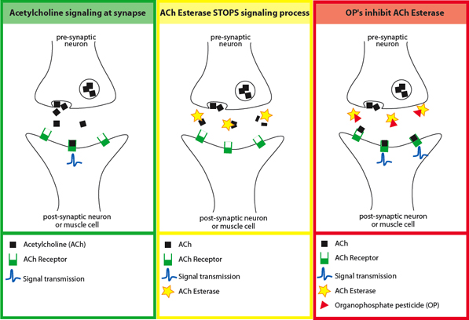

Slide 4
Selective Toxicity
Highly toxic to insects
Low mammalian toxicity
  oral LD₅₀ in rats is 885 mg/kg
  dermal LD₅₀ in rabbits is 4,000 mg/kg
Malaoxon = toxic form

Slide 5
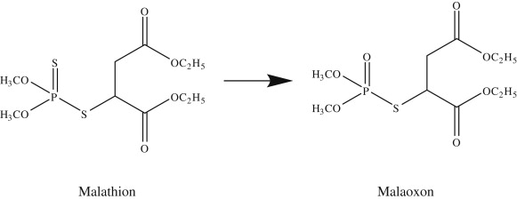
Mode of Action

Slide 6
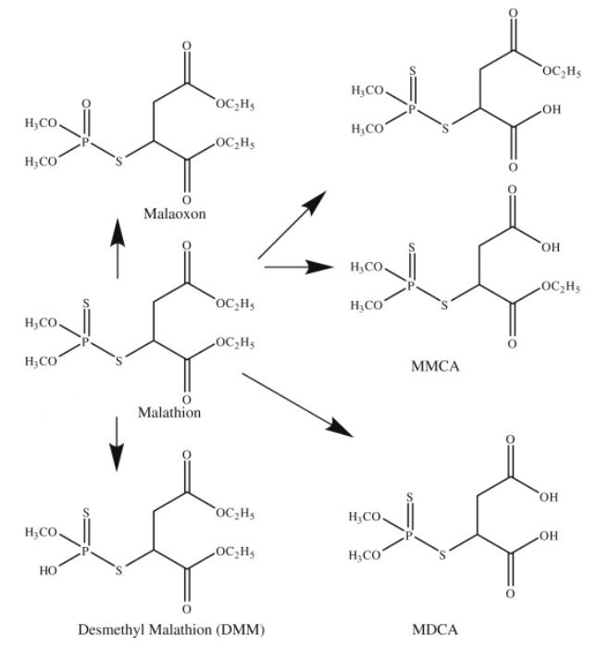
Degradation Pathways

Slide 7
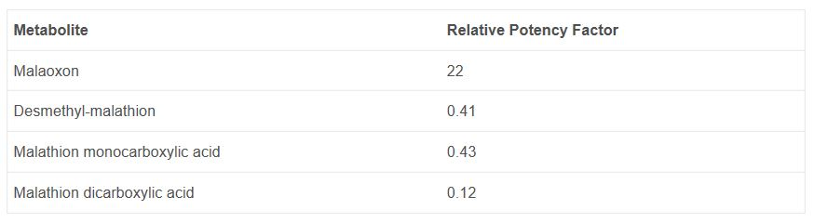
Estimated Relative Potency Factors for Acetylcholinesterase Inhibition

Slide 8
Insects vs. Mammals
Insects
Follow main pathway
Metabolized less quickly
Mammals
Amount of malaoxon formed is small
Rapid metabolism by detoxifying enzymes
Degraded relatively quickly in the environment

Slide 9
Other properties
Not a teratogen
Impurities enhance toxicity
  Isomalathion
    Inhibits acetylcholinesterase
    Inhibits carboxylesterases

Slide 10
Sources
https://www.merckvetmanual.com/toxicology/insecticide-and-acaricide-organic-toxicity/organophosphates-toxicity
https://www.sciencedirect.com/science/article/pii/B9780123743671000719
http://pmep.cce.cornell.edu/profiles/extoxnet/haloxyfop-methylparathion/malathion-ext.html
http://eawag-bbd.ethz.ch/mal/mal_map.html
http://depts.washington.edu/opchild/images/ach.jpg4

