Slide 1
Calming Pheromones
Products for dogs and cats
M.P.

Slide 2
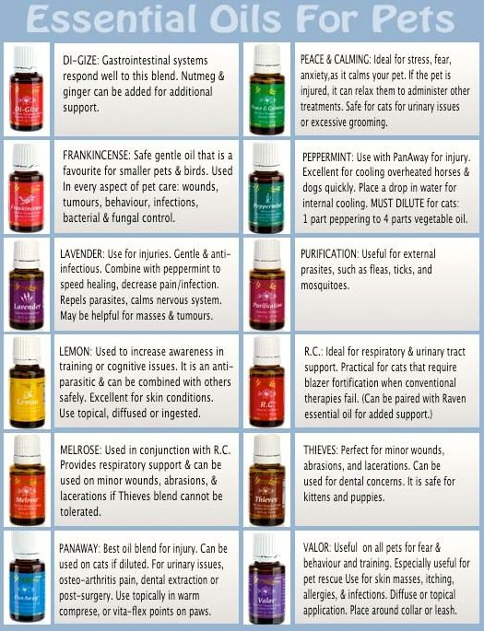
Scents and pheromones
Pheromones are released by animals for multiple reasons
The use of calming products use essential oils, synthetic pheromones and natural pheromones

Slide 3
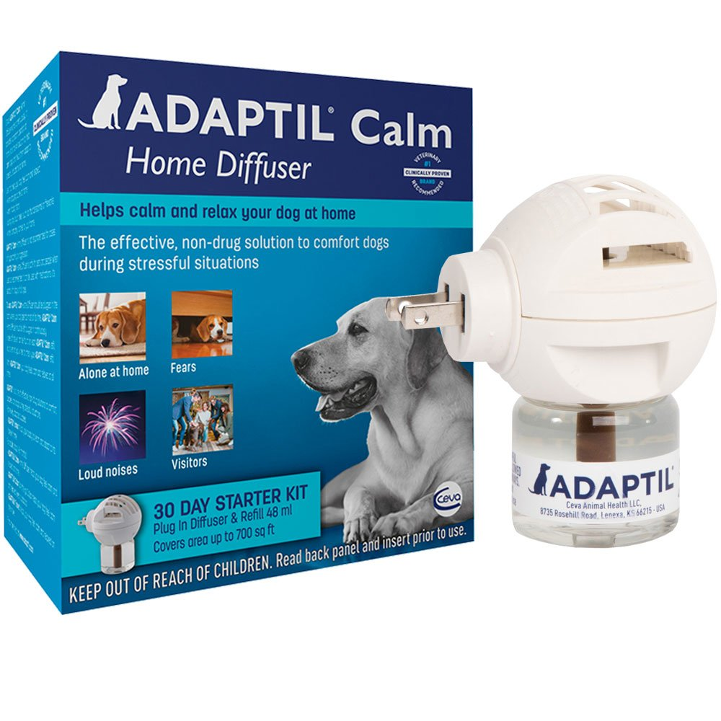
Plug in Diffusers
DAP, a pheromone released by the mother dog 3-5 days after having a litter of puppies.
Covers an area of 530-750 square feet with each vial and lasts up to 4 weeks.

Slide 4
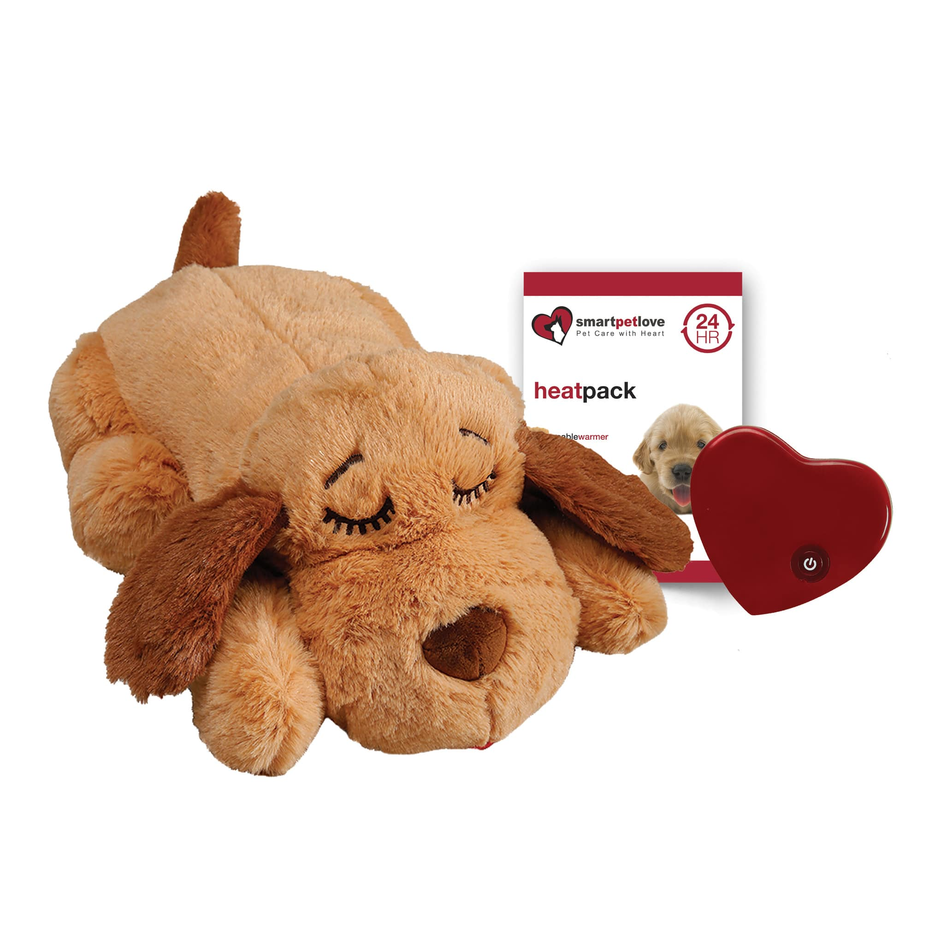
Snuggle Puppy
Helps when puppy is separated from mother
Provides heat and a heartbeat

Slide 5
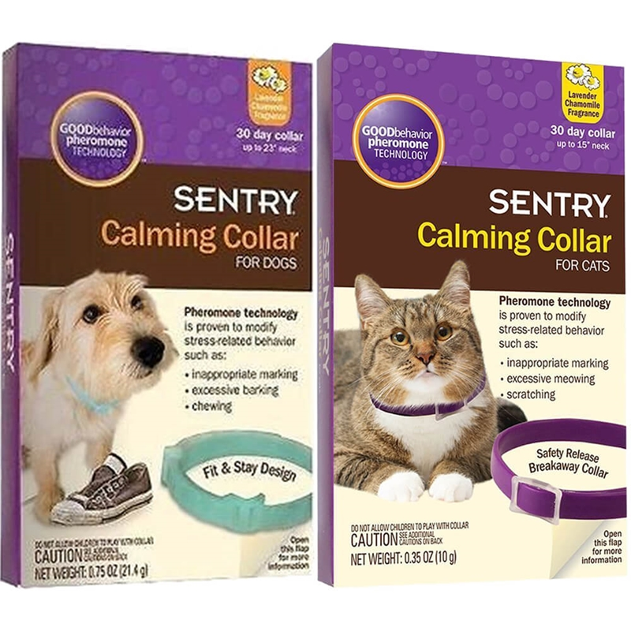
Calming collars
Mimicking a mother’s natural nursing pheromones.
Lasts up to 4 weeks.

Slide 6
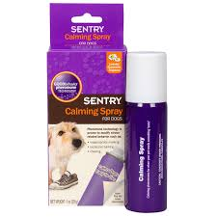
Sprays
“Comforting messages” (dog appeasing pheromones (DAP))
Usually odorless to humans
Do not spray directly on dog

Slide 7
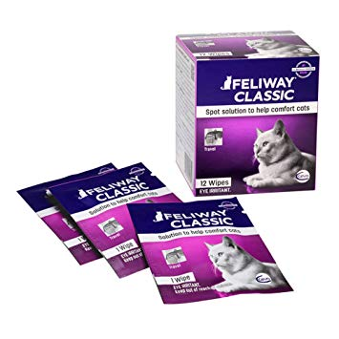
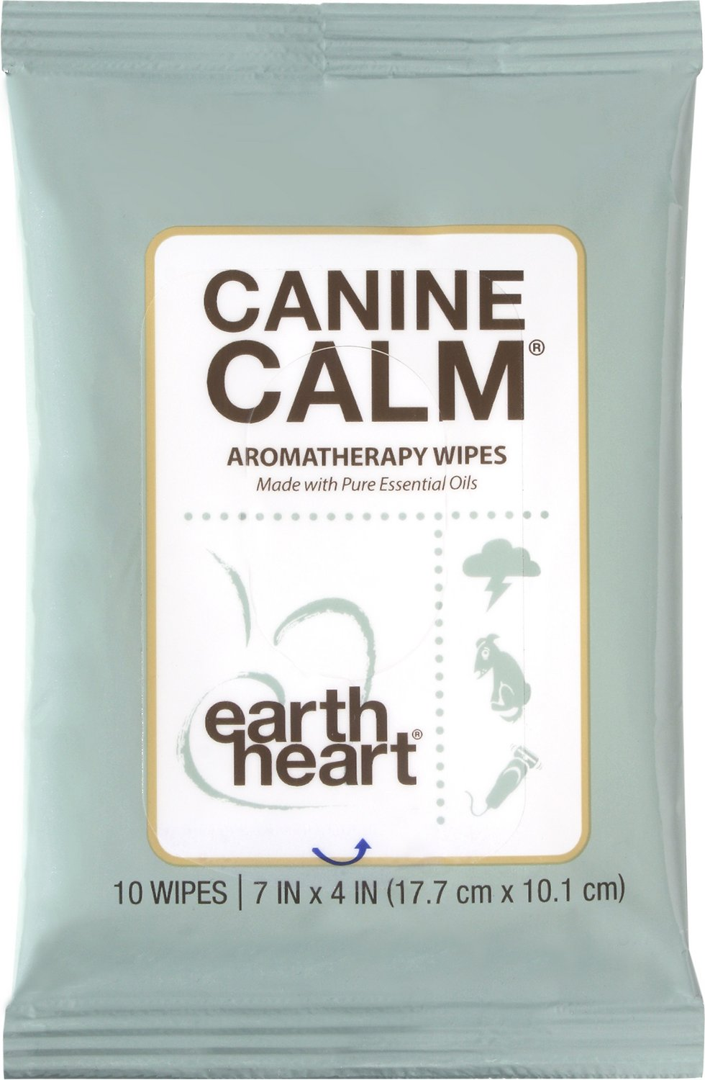
wipes
Mimic a cat’s natural facial pheromones, which creates a state of familiarity and security
Wipe down hard surfaces like his carrier
Re-apply every four to five hours, and you've got stress relief on the go.
Just use one wipe to gently massage your dogs’ outer ears, face and body as often as needed
Essential oils including bergamot, tangerine, lavender and marjoram
Dog product not recommended for cats, birds or reptiles

