Slide 1
Service Dogs
Rhyne Booker
Show, Tell, & Learn

Slide 2
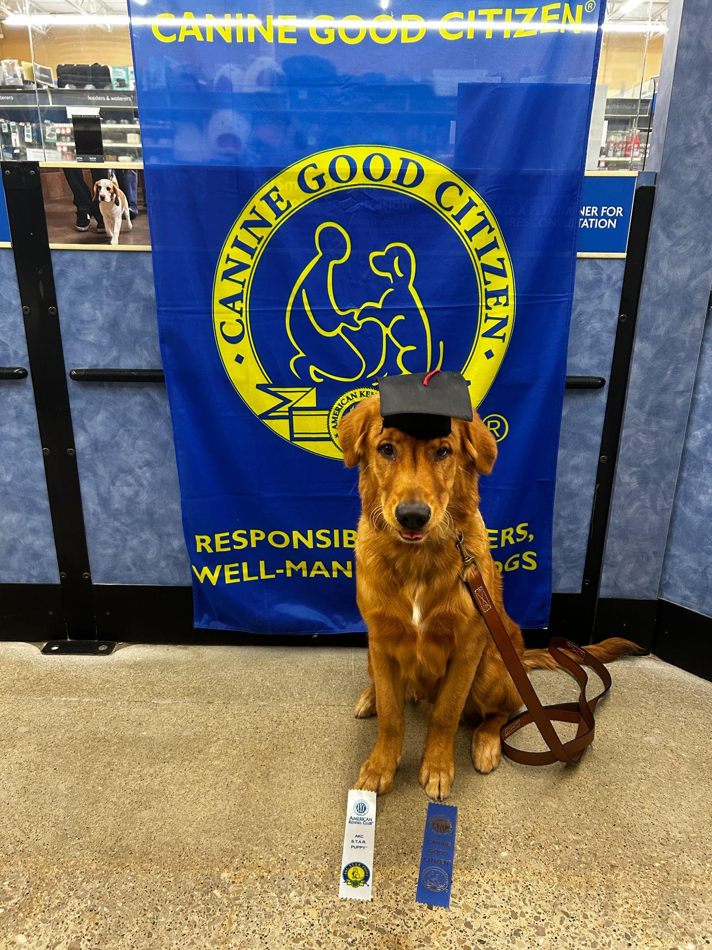
Meet Orion!
8 months old
Golden Retriever
Written In The Stars 'Orion' CGC
Medical Alert/ Psychiatric Service Dog (in training**)

Slide 3
Americans with Disabilities Act of 1990
Landmark piece of legislation in the United States
Prohibit discrimination against individuals with disabilities in several key areas including:
Employment: Employers cannot discriminate against qualified individuals with disabilities in hiring, promotions, or any employment-related activities.
Public Services: State and local governments must ensure that people with disabilities have equal access to public services and programs.
Public Accommodations: Businesses and organizations that serve the public must provide equal access to their facilities and services, which includes making reasonable modifications for individuals with disabilities.
Telecommunications: The ADA mandates that telecommunications services must be accessible to individuals with hearing and speech disabilities.
Miscellaneous Provisions: It also covers areas like transportation, access to technology, and various other services.

Slide 4
Continued Advocacy and Litigation: Disability rights advocates continue to work on expanding protections, enforcing existing laws, and addressing new challenges in accessibility and discrimination.
Section 504 of the Rehabilitation Act: This act prohibits discrimination against individuals with disabilities in federal programs and activities.
ADA Enactment: The Americans with Disabilities Act is signed into law on July 26 by President George H.W. Bush.
1973
1986
1990
2008
Ongoing
The ADA Bill Introduction: The first version of the ADA is introduced in Congress.
ADA Amendments Act: The ADAAA is signed into law, broadening the definition of disability and making it easier for individuals to prove they have a disability.

Slide 5
What is a Service Animal?
A service animal is specially trained to help people with disabilities perform specific tasks related to their condition.
The key points are:
Training: Service animals are trained to perform tasks that directly assist their owners.
Legal Definition: Under U.S. law (ADA), only dogs are recognized as service animals; other animals, like emotional support animals, don’t have the same access rights.
Access Rights: Service animals are allowed in public spaces where pets typically aren’t permitted, such as restaurants, stores, and public transportation.
Exceptions: Medical, Churches
In short, service animals play a crucial role in helping individuals with disabilities lead more independent lives.

Slide 6
What is the Difference?
Therapy Animal
Emotional Support Animal (ESA)
Service Dog
Comfort, support, affection
Many animals
Hospitals, nursing homes, schools, disaster relief areas
Volunteers
Training
socialization
No public access unless granted
Comfort and companionship
Typically a dog or cat
Can be any pet
No training
Fair Housing Act (FHA) allows ESA’s in ‘no pet’ housing
Documentation needed
No public access
Assistance to a disability
Dogs and miniature horses only
Extensive training
2 years minimum
Task trained
Public access

Slide 7
Training
Basic Obedience Training
Commands
Sit, stay, down, come, heel
Socialization
Comfortable around people, other animals, and various environments
Task-Specific Training
Vary
Guide tasks, hearing alerts, mobility assistance, medical alert, psychiatric response
Public Access Training
Ignore distractions
Food, other animals, loud noises
Remain calm
No reactivity or aggression
Responding to handler

Slide 8
Training continued…
Behavioral Training
Calm demeanor, non-aggressive, able to handle stressful situations
Without becoming anxious or overly excited
Handler Training
How to work effectively with their dog
Communication, understanding, proper care and handling
Certification **
Optional (more on next slide)
Training programs offer to ensure a standard of training and behavior
Duration
Several months to two years
Depends on the dogs age, breed, and complexity of tasks
Who can train a service dog?
Organizations or the owner

Slide 9
Do Service Dogs have to be Registered/Certified?
No.
ADA does not mandate any form of certification for service dogs, nor is it required by law
No official registry recognized by the ADA
Some organizations offer certification or registration, but this does not confer any additional rights

Slide 10
Types of Service Dogs
Guide Dogs
Function: help visually impaired navigate obstacles and provide guidance
Training: follow commands and navigate complex environments
Hearing Dogs
Function: alert individuals who are hearing impaired to important sounds
Training: learn to respond to specific sounds and signal their owner
Mobility Assistance Dog
Function: help individuals with physical disabilities
Training: provide physical support and perform specific mobility related tasks
Retrieving items, providing stability, assisting with walking
Medical Alert Dog
Function: alert handlers to medical conditions
Seizures, blood sugar, or allergies
Training: trained to recognize specific medical conditions and signal their handler or take action
E.g., alerting someone nearby

Slide 11
Types of Service Dogs Continued…
Psychiatric Service Dogs
Function: assist individuals with mental health conditions
PTSD, anxiety, or severe depression
Can provide grounding, interrupt harmful behaviors, or create a sense of security
Training: trained to perform tasks that help mitigate the effects of the handler’s condition
Medication reminders or creating a buffer in crowded places
Autism Service Dog
Function: assist individuals with ASD
Training: recognize signs of distress or anxiety and offer comfort, as well as to help with social cues
Can help with social interactions, prevent wandering, and ensure safety
A service dog can serve multiple purposes and have many different tasks to help mitigate their handlers disability

Slide 12
Can any dog be a Service Dog?
Yes and no
Specific traits are desired
Some breeds may not be the best fit
Fab Four
Labrador Retriever, Golden Retriever, German Shepherd, Poodle
Favored because of their temperament, trainability, and ability to perform various tasks effectively
Known time and time again for their high success: low wash rates
That being said
It is a mixed opinionated society on if any dog can be a service dog. They just need to be willing to do the work and have the correct attitude when it comes to doing it.
Some breeds are better at certain jobs

Slide 13
Service Dogs in Public
Questions
A business is allowed to ask two questions when a dog enters a non-pet friendly store
Is the dog a service animal required because of a disability?
What work or task has the dog been trained to perform?
They are not allowed to:
Ask about the persons disability, require documentation, request the dogs training certification, charge extra fees
Not required to wear a vest or identification, though many choose to do so to signify their status
Behavior Expectations
If a dog is disruptive or aggressive the establishment has the right to ask the dog to leave
Some dogs may bark or jump to alert their handler
Interactions
While in public, service dogs and their handlers should be given space and left uninterrupted
No talking to the dog, no petting the dog
It is up to the handler to permit or deny petting based on the dogs training and focus
Distracting a service dog interferes with its ability to do its job
E.g., medical alert dogs could miss changes in the handler and cause them to have a medical episode

Slide 14
Real vs. Fake Service Dogs
Real Service Dogs
Task-oriented
Owner focused
Non-reactive
Fake Service Dogs
Lack of adequate training
ESA’s
False documentation
Reactive/ disruptive
Consequences of Fake Service Dogs
Undermining the system
Leads towards skepticism towards legitimate service dogs
Increased scrutiny and challenges for those who truly rely on these animals
Safety risks
Risk to the public and legitimate service dogs
Particularly if they are aggressive or poorly trained

